Slide 1
Chapter 3
Arithmetic for Computers
Notes:
Morgan Kaufmann Publishers
Chapter 3 — Arithmetic for Computers

Slide 2
Multiplication
§3.3 Multiplication
Start with long-multiplication approach
multiplicand
1000
× 1001
1000
0000
0000
1000
1001000
multiplier
product
Length of product is the sum of operand lengths
Chapter 3 — Arithmetic for Computers — <number>
Notes:
Morgan Kaufmann Publishers
Chapter 3 — Arithmetic for Computers

Slide 3


Multiplication Hardware – Circuit 1
Initially 0
Chapter 3 — Arithmetic for Computers — <number>
Notes:
Morgan Kaufmann Publishers
Chapter 3 — Arithmetic for Computers

Slide 4
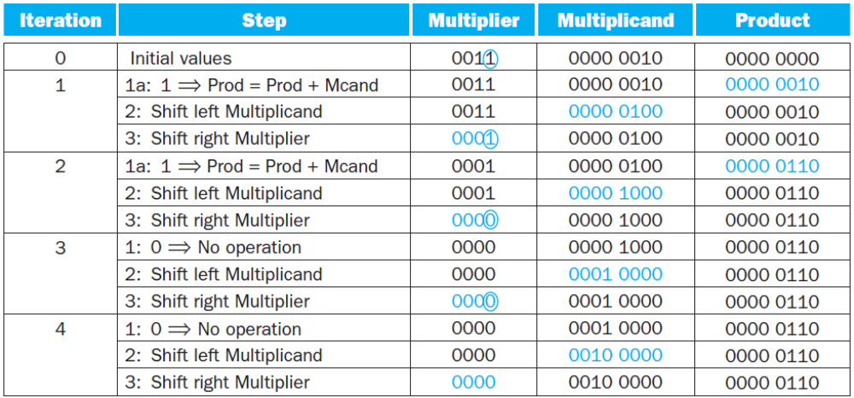
Multiplication Hardware – Circuit 1
Example: Using 4-bit numbers to save space, multiply 2_{ten} 3_{ten}, or 0010_{two} 0011_{two}
Chapter 3 — Arithmetic for Computers — <number>

Slide 5

Optimized Multiplier
Perform steps in parallel: add/shift
Half size
No Multiplier register
One cycle per partial-product addition
  That’s ok, if frequency of multiplications is low
Chapter 3 — Arithmetic for Computers — <number>
Notes:
Morgan Kaufmann Publishers
Chapter 3 — Arithmetic for Computers

Slide 6
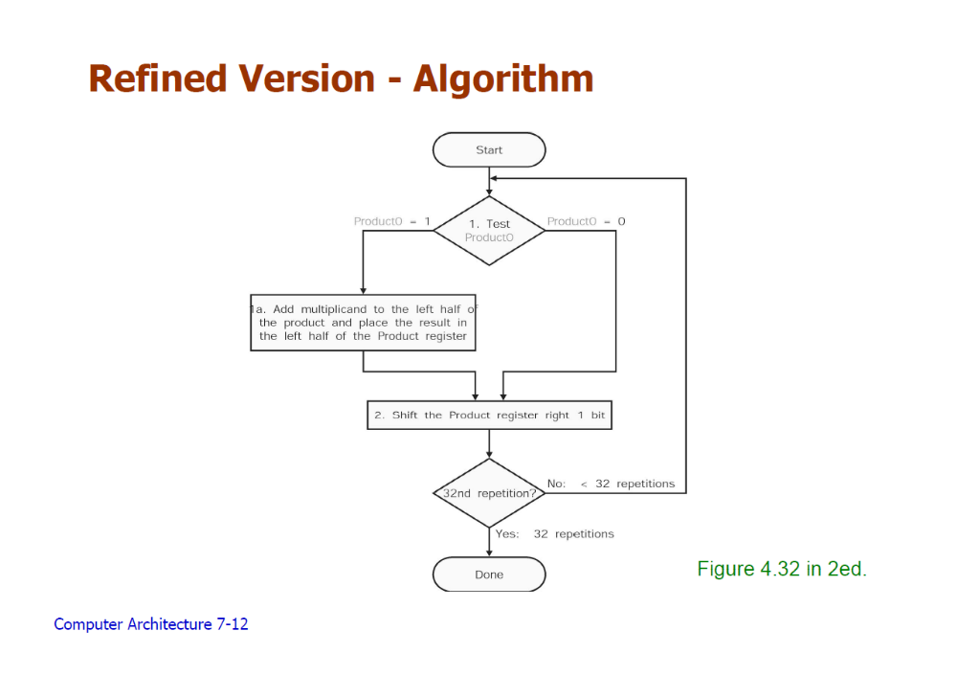
Optimized Multiplier Algorithm
Chapter 3 — Arithmetic for Computers — <number>

Slide 7
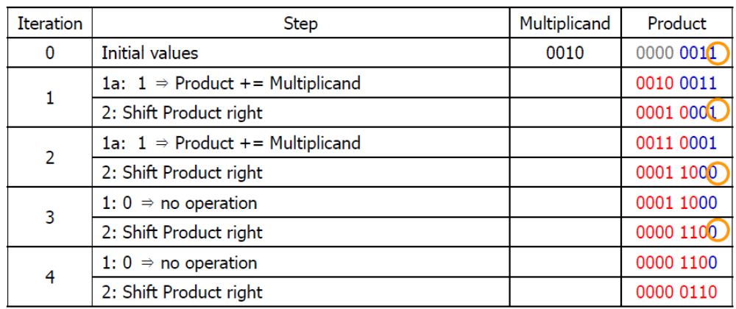
Optimized Multiplier Example 1
Example: Using 4-bit numbers to save space, multiply 2_{ten} 3_{ten}, or 0010_{two} 0011_{two}
Chapter 3 — Arithmetic for Computers — <number>

Slide 8
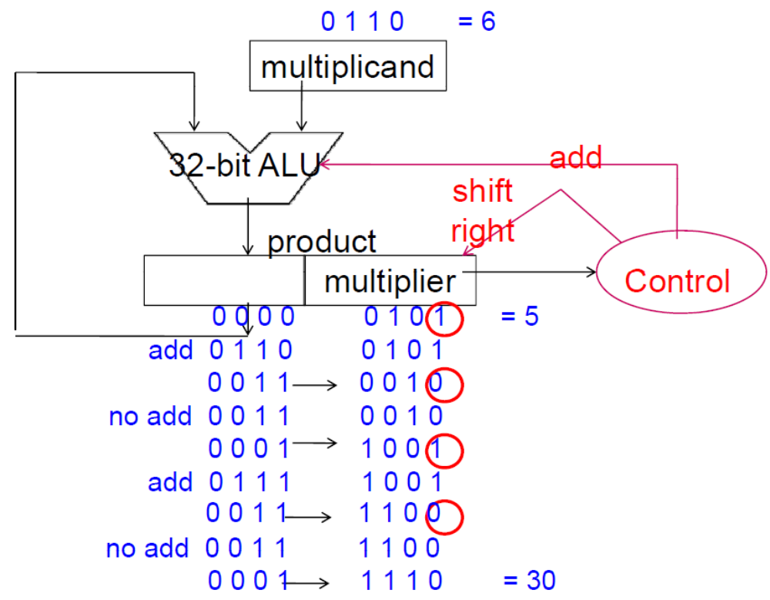
Optimized Multiplier Example 2
Example: Using 4-bit numbers to save space, multiply 6_{ten} 5_{ten}, or 0101_{two} 0110_{two}
0
1
1
0
Chapter 3 — Arithmetic for Computers — <number>

Slide 9
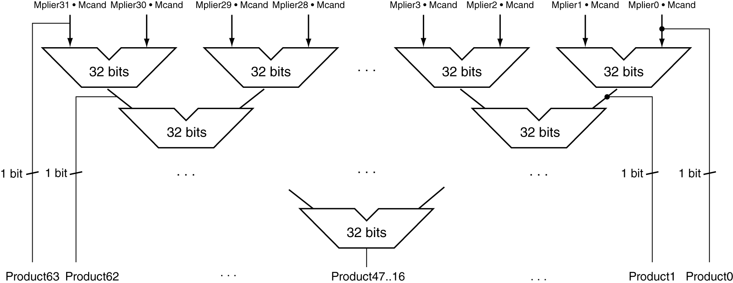
Faster Multiplier
Uses multiple adders
  Cost/performance tradeoff
Can be pipelined
  Several multiplication performed in parallel
Chapter 3 — Arithmetic for Computers — <number>
Notes:
Morgan Kaufmann Publishers
Chapter 3 — Arithmetic for Computers

Slide 10
MIPS Multiplication
Two 32-bit registers for product
  HI: most-significant 32 bits
  LO: least-significant 32-bits
Instructions
  mult rs, rt / multu rs, rt
    64-bit product in HI/LO
  mfhi rd / mflo rd
    Move from HI/LO to rd
    Can test HI value to see if product overflows 32 bits
  mul rd, rs, rt
    Least-significant 32 bits of product –> rd
Chapter 3 — Arithmetic for Computers — <number>
Notes:
Morgan Kaufmann Publishers
Chapter 3 — Arithmetic for Computers

Slide 11
MIPS Refined Multiplier Version
Chapter 3 — Arithmetic for Computers — <number>

